Slide 1
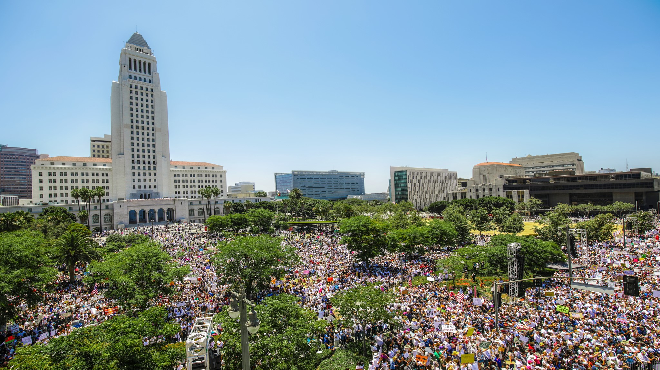




Los Angeles Countywide Outreach for:
Program Overview
Presentation for: SCAG 30th Annual Demographics Workshop
University of Southern California, Los Angeles, CA
----------
June 11, 2019

Slide 2
LA County CCC Goals and Objectives
Identify the County and City of Los Angeles as the co-leads of the Countywide Outreach CCC.
Build partnerships with various sectors to develop an effective outreach campaign.
Develop a Countywide education and outreach plan to:
  Educate partners on the importance of the 2020 Census.
  Mobilize partners to deliver the tested 2020 Census messages.
  Activate direct “On-the-Ground” outreach through:
    Census Action Kiosks (CAKs), 2. Census Goodwill Ambassadors (CGAs), and 3. “Adopt-a-Block Group” and/or “Adopt-a-Population” commitments.
Develop effective messaging Countywide, focusing on Hard-to-Survey populations, and in appropriate languages. Avoid duplication of efforts and maximize limited resources.
Identify outreach capacity of partners and determine how to fill any gaps.
Adopt the Statewide “On-the-Ground” and “On-the-Air” outreach models at the Countywide level.

Slide 3
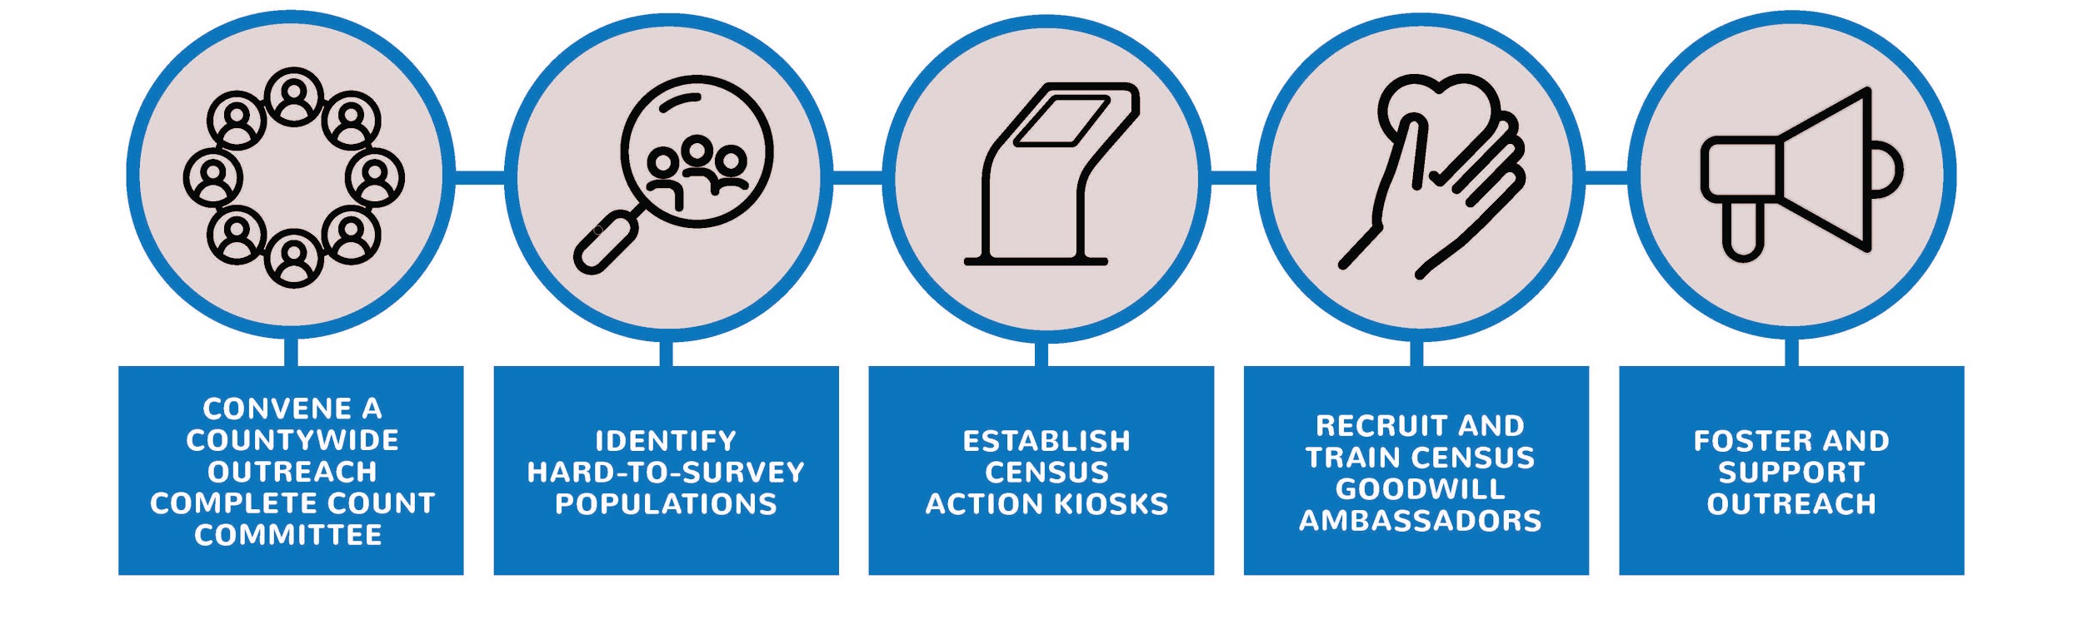
LA’s Census 2020 Five Pillar Strategy
To coordinate local outreach efforts

Slide 4
L.A. County Complete Count Committee & Subcommittees
Countywide Outreach Complete Count Committee
Includes:
City/County departments
K-12
Higher education
Interfaith organizations
Community organizations
Unions
Business/Chambers
Transportation
Health and Human Services
Municipalities
Stakeholder/ Community Table
Census Action Kiosks (CAK)
Next Meeting on Thursday, July 25, 2019 at 9:30 AM, Kenneth Hahn Hall of Administration

Slide 5
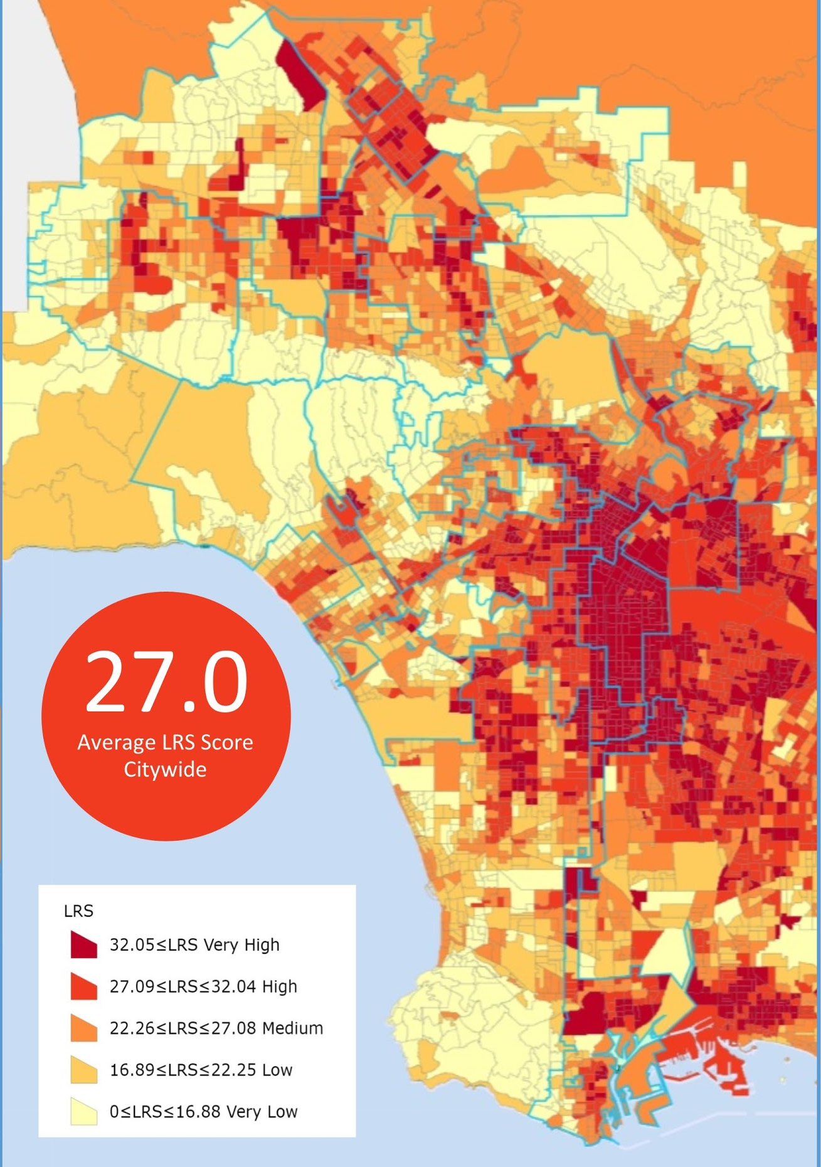
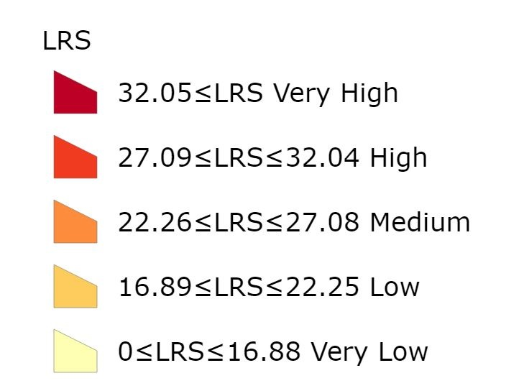
LA City Hard-to-Survey Populations
http://rpgis.isd.lacounty.gov/lrs/

Slide 6
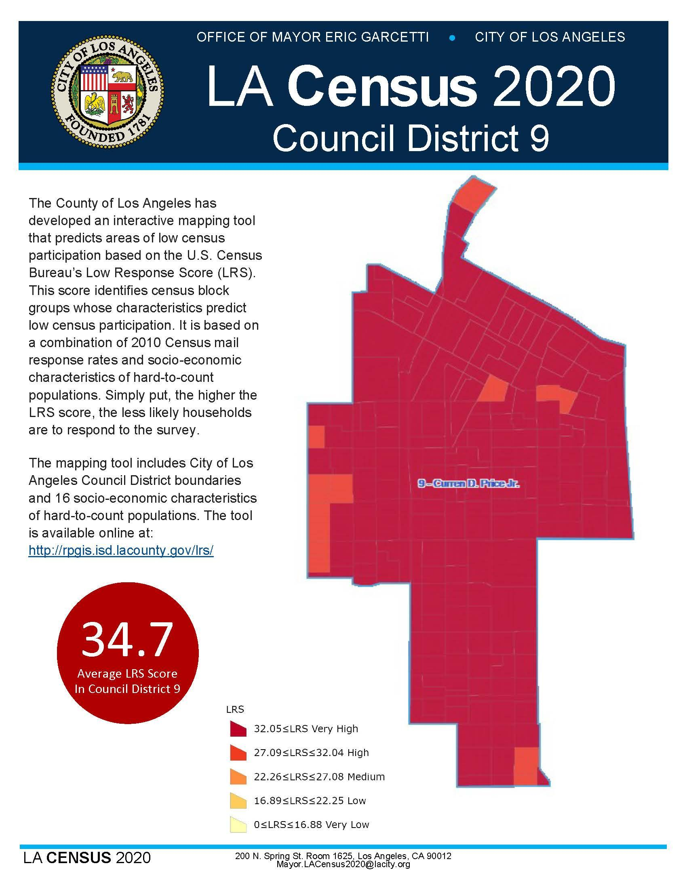
Quick Facts
CD 9 is among the hardest to count council districts citywide. With the exception of a few census block groups all have very high LRS scores.
Council District 9 has a lower median household income, a higher percentage of African-American and Latino residents, a higher percentage of residents living in poverty and a higher percentage of non-high school graduates than city averages, which are key indicators of hard to count populations.
(These 16 socio-economic characteristics are highly correlated with hard-to-count populations and may help inform outreach strategies)
Median Household Income | $29,561 | Not High School Graduate | 56.6%
Asian | 1.5% | Renter Occupied Housing Units | 72.5%
Hispanic | 79.9% | Vacant Housing Units | 7.7%
Non-Hispanic White | 2.1% | Limited English Age 14+ | 25.6%
Non-Hispanic Black | 15.7% | Population Age 18-24 | 14.1%
Native Hawaiian or Other Pacific Islander | .1% | Population Age 65+ | 5.8%
American Indian or Alaskan Native | 0.1% | Family Occupied Housing Units with Related Children Under Age 6 | 34.4%
Below Poverty Level | 42.0% | Multi-Unit (10+) Housing | 13.6%
Neighborhoods with Census Block Groups that have “Very High” LRS Scores:
Central, Downtown, Exposition Park, Florence-Firestone, Green Meadows, Harvard Park, South Park, University Park, Vermont Central, Vermont Square, Vermont Vista, West Vermont, Wholesale District, and Wilshire Center
Neighborhoods with Census Block Groups that have “High” LRS Scores:
Central Green Meadows, Harvard Park, Vermont Square, and West Vernon

Slide 7

Census Action Kiosks
Increase access to the new digital census and create a uniform user experience countywide

Slide 8
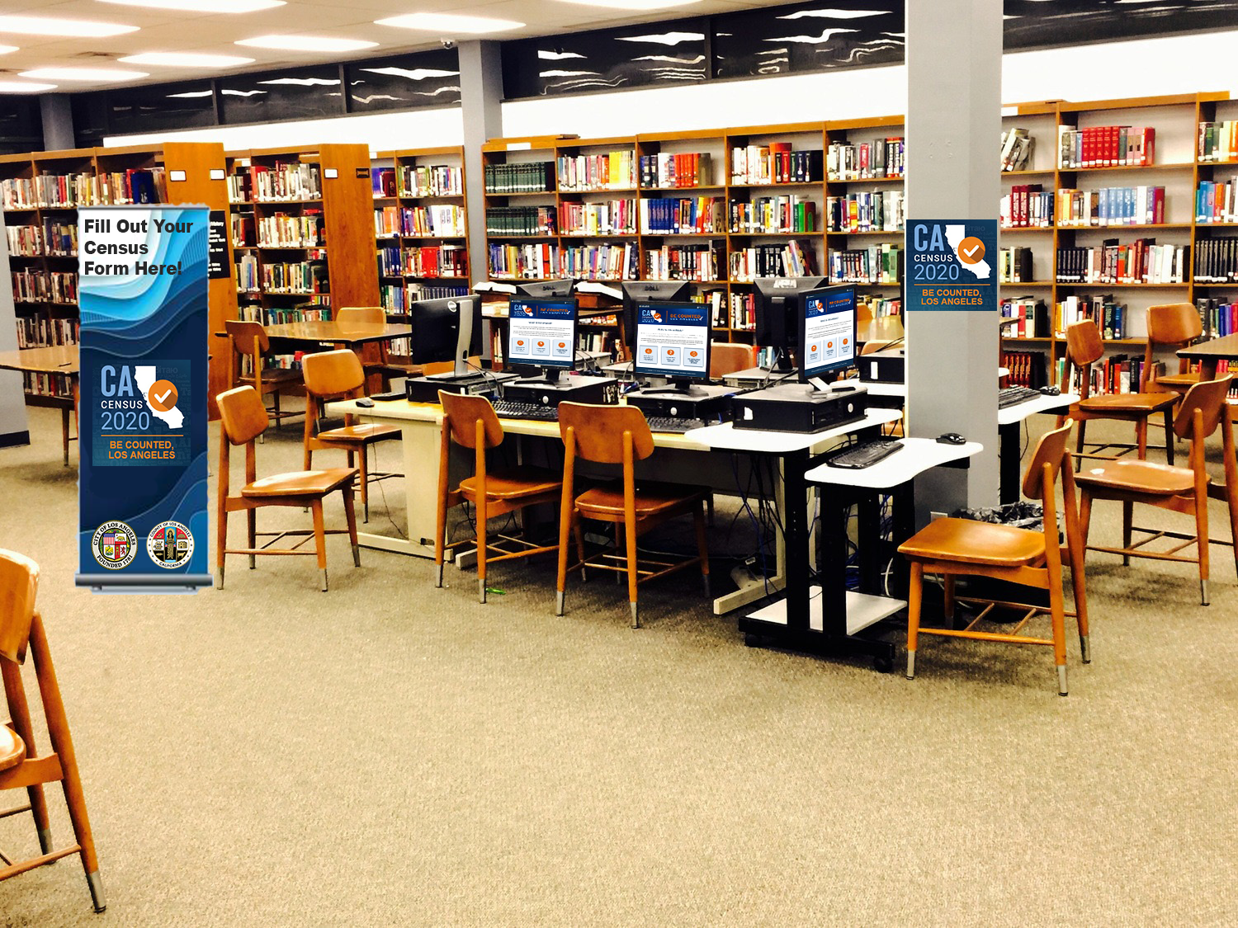
Census Action Kiosk (CAK) Prototype
Utilize public computers with internet access
Equip computers with internally developed Census 2020 webpage
Outfit computer stations with marketing/branding material
Activation period: March 2020 to July 2020
Register/Sign up your location by May 17, 2019
For more information, please visit: https://census.lacounty.gov/countywide-outreach-ccc/census-action-kiosk-cak-subcommittee/

Slide 9
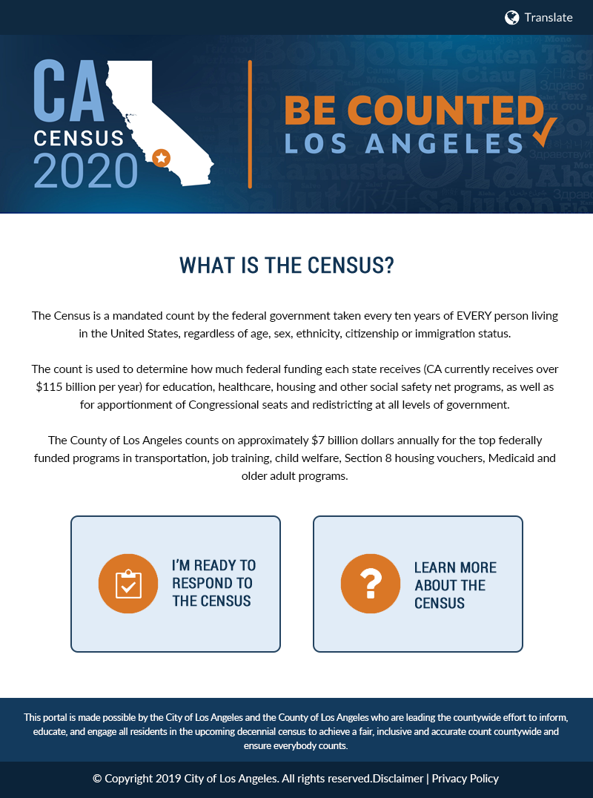
CAK Webpage Prototype
Centered on 2 user experiences
  1: “I’m ready to respond to the Census”
  2: “Learn more about the Census”
Google translate enabled
U.S. Workforce Rehabilitation Act, Section 508 Compliant

Slide 10

Census Goodwill Ambassadors
Recruit, train and deploy trusted messengers to educate, motivate, and activate HTC populations countywide.

Slide 11

Census Goodwill Ambassadors
Volunteers from the community and government agencies will assist with education and outreach for the 2020 Census.
  Staff a Census Action Kiosk (CAK)
  Lead a community event in HTC neighborhood
  Volunteer at City/County events
  Promote the Census on social media
  Recruit more ambassadors
  Participate in get out the count activities during the Non-response follow up period (NRFU)
Requirements
  Must be at least 18 years old
  Register and sign a code of conduct, waiver of liability and photo release
  Participate in at least 1 event for Pilot Program Participants.

Slide 12
Call to Action
Make Census 2020 a policy and fiscal priority
Adopt a resolution, motion, or issue an memo
Join or form a complete count committee
Form partnerships with trusted messengers and your regional census office
Host a Census Action Kiosk
Recruit volunteers
Incorporate census messages into existing programs, services and communications.

Slide 13
Contact Information
For more information on the City and County of LA’s Complete Count activities, please contact:
City of Los Angeles
Maria de la Luz Garcia
Director, Census 2020 Initiative
Office of Mayor Eric Garcetti
(213) 922-9768
maria.garcia@lacity.org
County of Los Angeles
Avianna Uribe
Chief Executive Office
County of Los Angeles
auribe@ceo.lacounty.gov

Slide 14

Be Counted,
Los Angeles!

